Slide 1


Electricity Authority
Stakeholder perception review
Final Report
A qualitative study
September 2022

Slide 2

Table of contents
1.
Executive summary
2.
Research need and approach
3.
Stakeholder perceptions of issues facing the electricity sector
4.
Stakeholder perceptions of the Electricity Authority’s performance against its statutory objective
5.
Stakeholder perceptions of the Electricity Authority as a regulator
6.
Stakeholder perceptions of the Electricity Authority's engagement and communications
7.
Stakeholder views of how to effectively move forward

Slide 3

1.
Executive summary

Slide 4
Executive summary
Effective engagement remains key for stakeholders to feel confident in the regulator and the decisions it makes. Stakeholders need to respect the Authority and have confidence in the regulatory regime and processes. Stakeholders recommend this can be achieved through making improvements to the following areas:
The Electricity Authority’s (the Authority’s) statutory objective is to promote competition in, reliable supply by, and the efficient operation of, the New Zealand electricity industry for the long-term benefit of consumers. Stakeholder engagement is a key priority for the Authority; it contributes to robust, well-informed and well-reasoned decision-making, and helps build and maintain trust in the regulator.
A series of 30 qualitative interviews were undertaken with stakeholders, of which 16 were with sector participants (generators, gentailers, distributors, retailers) and 14 were with non-sector participants (Government agencies, consumer representatives, media, consultants). Interviews were undertaken online and lasted up to an hour each. Fieldwork took place during July/August 2022.
This study sought to replicate qualitative research undertaken in 2018. Similarities and differences have been highlighted throughout the report.
1.
2.
Provide greater regulatory certainty
Stakeholders suggest there is a need for the Authority to ensure the regimes and processes in place are fit for purpose.
Many express concern that ‘technology is moving faster than the rules’. Others raise questions about perceived political influence.
These factors are destabilising and the uncertainty created does little to encourage capital investment. Stakeholders desire less complexity, bureaucracy and greater clarity around some rules/measures.
This is an enduring theme across 2018/2022.
Build capacity and capability of Authority staff
Stakeholders are aware of staff churn across all levels of the Authority.
Many perceive the Authority lacks the appropriate resourcing required to perform their functions (evidenced by their slow response, the time taken to gain any traction). Similarly, stakeholders believe the Authority has lost considerable institutional knowledge and industry expertise.
This is significant concern, given the potential wide reaching ramifications of recommendations made by staff, whom industry do not perceive to be suitably qualified. Stakeholders suggest, if the Authority lacks expertise in-house, they should seek to outsource it.
This is an emerging theme in 2022.

Slide 5
Effective engagement remains key for stakeholders to feel confident in the regulator and the decisions it makes. Stakeholders need to respect the Authority and have confidence in the regulatory regime and processes. This can be achieved through making improvements to the following areas: continued
3.
4.
5.
Strong future focus
Stakeholders acknowledge that there are significant changes on the horizon, both in terms of technology and also the shift towards renewable energy.
There is a need to create an environment where (new) technology can flourish.
Stakeholders suggest existing frameworks may not be fit for purpose and there is a need for the Authority to be agile and adapt to an ever evolving environment.
This is an enduring theme, with greater prominence in 2022.
Greater collaboration with industry
Stakeholders desire more meaningful engagement with the Authority.
There is a sense that engagement/consultation by the Authority is insincere and they are simply going ‘through the motions’. Stakeholders recall multiple examples of having invested significant resourcing into submissions, with very little material effect.
Stakeholders perceive multiple benefits for the sector overall, should the Authority take steps to proactively engage with industry and build their understanding. Stakeholders suggest site visits to the regions, hosting forums, along with overtly communicating strategy/vision for the sector as starting points.
This is an enduring theme, with greater prominence in 2022.
Increased pragmatism
Many stakeholders are critical about what they deem to be an outdated economic model, and express concern that the Authority’s (overly) theoretical approach is at the expense of pragmatism.
Stakeholders suggest the Authority needs to give greater consideration to real world impacts (which is particularly relevant in the current dynamic environment).
This is an enduring theme across 2018/2022.

Slide 6

2.
Research need and approach

Slide 7

The need for research
Stakeholder engagement is a key priority for the Authority, and one of continuous improvement. Effective engagement is critical for the successful design and implementation of regulations. It contributes to robust, well-informed and well-reasoned decision-making, and helps build and maintain trust in the regulator.
The Authority commissioned a qualitative stakeholder study in 2017/2018 with senior level stakeholders (sector and non-sector), including Board Chairs and Chief Executives. The research suggested a number of improvements. Since then, the Authority has gone through some significant changes with the appointment of new board members and Chief Executive, along with a strategy reset.
With a continued focus on stakeholder engagement, the Authority sought to replicate the 2017/2018 study in the current climate.
The Electricity Authority (Authority) was established as an independent Crown entity by the Electricity Industry Act 2010 (Act).
The Authority’s statutory objective is to promote competition in, reliable supply by, and the efficient operation of, the New Zealand electricity industry for the long-term benefit of consumers.
It provides independent regulation and governance of the electricity industry and oversees the operation of the New Zealand electricity system and markets.

Slide 8
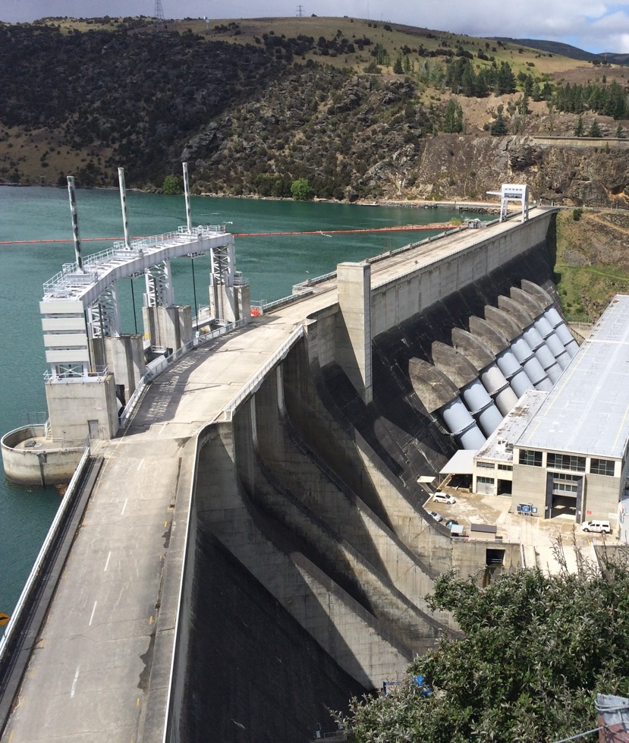
Research purpose
The objectives of the 2022 review are to:
a.
assess perceptions and attitudes of key Authority stakeholders for their views on issues facing the electricity sector, the Authority, and its communications
b.
provide information to inform the Authority’s future communications and stakeholder engagement strategies
c.
advise the Authority Board and staff of the current state (noting any changes since 2018), and any opportunities for improvement.

Slide 9




Qualitative research approach
Given the exploratory nature of the research, a qualitative approach was utilised.
This consisted of in-depth interviews with a range of senior level stakeholders, including Chairs of Boards, Board members, Chief Executives, Chief Operating Officers, Executive Directors, and Consultants.
Interviews were conducted online (via Zoom or Teams) and lasted up to an hour each.
Fieldwork took place during July/August 2022.
Sector | Generators, gentailers, distributors, retailers | 16
Non-sector | Government agencies, consumer representatives, media, investors, consultants | 14
Total number of interviews | Total number of interviews | 30
Total number of participants *Two sector interviews were paired, with Regulatory Managers also attending the interviews. | Total number of participants *Two sector interviews were paired, with Regulatory Managers also attending the interviews. | 32

Slide 10
Notes to this report
Analysis
A thematic analysis of the data was undertaken, via a general inductive approach¹. This means outputs were guided by the specific research objectives and research findings emerged from the frequent, dominant or significant themes inherent in the raw data.
Utilising a team approach to undertake and analyse interviews was a deliberate strategy employed to ensure one particular world view did not unduly influence overall findings. The research team continuously discussed and debated outputs, re-visiting the raw data to ensure robust results.
The researchers note that some findings are polarised in nature. During the formal analysis process we sought to identify underlying drivers influencing the disparity in attitudes and perceptions. Some of the variables explored included industry type, organisation size, length of time in industry, engineering vs. general commercial background etc. However, specific variables could not be identified as underpinning opinion.
Terminology
Qualitative research seeks to explore and understand viewpoints, rather than measure them. As such, we avoid using terms such as ‘the majority’ or ‘the minority, although we do use ‘many’, ‘some’, and ‘a few’ to give an indication of the strength of a viewpoint.
Where differences in perceptions of various stakeholder groups are evident, these have been noted. Conversely, if no specific mention is made to stakeholder groups, perceptions exist across the sample.
Verbatim comments
Verbatim extracts from interviews are used throughout the report to illustrate key findings and ‘bring the research to life’ in participants’ own words. The number of verbatims used is not significant, they are simply to illustrate different perceptions.
Referencing of verbatims is deliberately undertaken at a broad level (sector vs. non-sector) to ensure participant confidentiality. Researchers spent considerable time assuring participants of the confidentiality of their response, to ensure open and frank feedback.
1. Thomas, D.R., A General Inductive Approach for Analyzing Qualitative Evaluation Data American Journal of Evaluation 27 (2), 237-246

Slide 11

3.
Stakeholder perceptions of issues facing the sector

Slide 12






Stakeholders identify a number of challenges (which may also be opportunities) facing the sector
Environmental
Political
Economic
Regulatory
Social
Resourcing

Slide 13

Environmental – climate change is top of mind
Environmental
Top of mind for many stakeholders is the impact of climate change and corresponding extreme weather events.
“The other problem New Zealand has, which it has always had, but will become more of an issue as time goes on with climate change, is what we call dry year risk, when you've got less water in the lakes. We had this last year, in the first half of 2021. We had very dry lakes. And we had a deficit when we were coming towards winter in June, July, with a shortage of water in the lakes… This needs to be thought through by the EA, urgently.”
Sector

Slide 14
Political – the independence of the Authority
Political
Stakeholders are critical of the lack of clarity between what they perceive to be Government ambition vs. statutory objective.
This highlights the importance of reinforcing the Electricity Authority’s political independence.
“It’s supposed to be a standalone regulatory authority for the benefit of the customers. Sure, it has to be taking into consideration the government policies, but only legislative policies, not open, wishful thinking statements [by the Government].”
Sector
“With the recent wholesale market review, the report was trying to optimise for political outcome, rather than statutory objective.”
Sector
“Political and regulatory intervention from the government is unneeded. You only need to go overseas to look at what's gone wrong… And that's particularly the biggest risk for regulators.”
Sector

Slide 15
Political – shift towards renewable energy
Political
Similarly, a significant issue facing the sector, and one that is top of mind for many stakeholders, is the shift towards renewable energy.
Stakeholders express considerable concerns, which appear to be primarily driven by uncertainty. This in turn raises many questions:
  Where is the new generation coming from?
  How can security of supply be guaranteed?
      What happens in dry seasons/periods with no wind?
      What will be used in place of thermal generation?
  How will new technologies be valued and deployed?
  Who is going to pay for the transition?
      How will costs be spread?
      Will it create social inequities for consumers?
  Are the right regulatory settings in place?
  Is the market structure fit for purpose?
“The people that will go there first are the wealthy and those that can afford it, they end up having a cost spread across them as well. So, there's a whole bunch of stuff in terms of equity, equity of rates, and things like that, which also come through. So, it's quite a lot going on.”
Sector

Slide 16
Economic – balancing economic theory with practical outcomes
Economic
Some stakeholders are critical of what they deem to be an outdated economic model. The common criticism is that it is an overly theoretical perspective, which lacks pragmatism.
A pure economic model is not perceived to be reflective of consumer behaviour. It does not take into account the effect behavioural economics has on the consumer.
Subsequently, the Authority is perceived to be rigid in their approach, not providing opportunity for other ideas.
Stakeholders suggest there is a fine line balancing economic theory with practical outcomes while ensuring industry expertise is acknowledged.
“Driving an economically pure approach, what they think is efficient, but actually, it's not, that's going to lead to huge complexity.”
Sector
“We are so hamstrung by archaic regulation.”
Non-sector
“The Authority have gone on a journey of change I would observe, from being quite economically doctrinaire at the expense of pragmatism, to potentially being more pragmatic, but along the way, having lost their industry expertise.”
Sector
“Sometimes, it looks as though they're not entirely aware of the trade offs that they incur by putting more complexity into the market. For example, things like the transmission pricing methodologies, you will hear all about understanding the intent to try and better align with incentives around where transmission costs go. But it obviously gets to a point, where it's just so complicated, it's a black box.”
Sector

Slide 17
Regulatory – settings that provide transparency
Regulatory
There is a sense that the regulatory environment needs to align with what is happening practically.
Some stakeholders suggest gentailers have an unfair advantage, manipulating their own pricing.
Others express concern about issues around transparency of new generation and the effect this will have on the market.
“The price is determined by a cartel of major generators, who are able to operate within the rules, and still maximise prices, because they will know what each other does… It's an open secret.”
Sector
“There's no shortage of transparency around the determination of the price. But there is a shortage of transparency around the development with that new generation because ultimately, in the theory of the market, it's all of that generation coming to market that causes competition, price to come down. If there's a shortage of supply, then the price can be as high as anybody wants.”
Sector

Slide 18
Social – potential for inequities
Social
Many stakeholders cite the increasing cost of electricity and shift towards renewable energy as a cause for concern:
The effect on consumers
The potential for social inequity.
“So, the potential inequality that comes from change, because change tends to drive allocation or cost. And it's the often the people who are most challenged by change, who are the ones who can't influence how the allocation occurs, or what the cost is likely to be. And unless it's managed properly, that burden will sit on our lower socio economic and other disadvantaged groups.”
Non-sector

Slide 19
Resourcing (in a post-COVID world)
Resourcing
In the post-COVID world, some stakeholders express concerns around resourcing:
Ensuring those in the sector have the right skills
Attracting (appropriately qualified) people to the regions
Supply chain disruptions.
“We've got challenges of attracting people to regional areas, we've got challenges in the current environment, particularly with likes of COVID and supply chain disruptions… there are fissures.”
Sector

Slide 20


Differences between 2018 and 2022
A number of themes remain consistent:
Climate change (and its effects) is still top of mind
Enduring perception that any political influence could be destabilising to the market
A pure economic model is outdated
Regulatory settings need to evolve, as technology evolves
Friction exists amongst key players (adversarial culture of the industry)
Potential for social inequities remains a concern.
  The overarching theme remains the same, the sector is looking to the Electricity Authority to provide regulatory certainty.
In 2018, there were comments about a lack of clarity around boundaries between the Commerce Commission and the Electricity Authority. This was not raised as an issue in the current research. However, in 2022 the Electricity Authority was often compared with the Commerce Commission, with the Commerce Commission being held up as an example for the Electricity Authority to emulate with stakeholders describing the Commerce Commission as being expert, confident, respected.

Slide 21

4.
Stakeholder perceptions of the
Electricity Authority’s performance
against its statutory objective

Slide 22
Stakeholders would like greater clarity of the metrics used to assess the Authority’s performance against its statutory objective
    To promote competition in, reliable supply of, and efficient operation of, the electricity industry for the long term benefit of consumers.
To some extent, stakeholders struggle to make an informed comment regarding the Authority’s performance against its statutory objective, as there is a lack of perceived clarity around key metrics.
“What I don't know is how they measure it. What do they do by way of an annual review that says these are our measurement points and says is the system more reliable or is it more efficient? Or is it more beneficial for long term? How do we actually measure and demonstrate the point?”
Sector

Slide 23
Stakeholders are somewhat polarised when considering the level of competition in the market
Some stakeholders are dismissive and suggest market competition is a facade.
Stakeholders who reference customer churn as a measure suggest competition is evident given consumers are switching providers, which is a function of consumer choice. However, others suggest this is not an accurate measure given the high level of customer inertia in the market.
Those who reference competition as a function of the number of retailers in the market suggest competition has increased, evidenced by new entrants into the market. However, others suggest competition is muted. While there may be new entrants, they appear to be having very little impact and not gaining any market share. Any activity is perceived to be happening on the ‘margins’, and the overall market share of the major players remains unchanged.
"I would not describe it as a competitive market. It's important to look at the different layers of the market. Transpower is its own state-owned thing. In distribution, there are natural geographical monopolies, so that's not counted. We're just talking about generation and retail generation, it's not like those companies need to compete with each other... there is the facade of competition but actually, it's muted at best."
Non-sector
“They say natural competition will provide competition, but there is a lot of customer inertia. It’s not realistic of customer behaviour.”
Sector
“New players come and go, but this doesn’t change the bottom line much.”
Sector
“So, the retail market can churn all at once. But if the wholesale price is too high, that's too high for everyone. That's the starting point. So, retail competition is not a proxy for wholesale competition.”
Sector

Slide 24
Stakeholders are somewhat polarised when considering the level of competition in the market, continued
Stakeholders also reference wholesale competition as a measure of competitiveness suggest the market is less competitive.
Some stakeholders are critical of the perceived influence of gentailers in the market. There are ongoing calls for vertical integration to be removed, for generation and retail activities to be split.
Similarly, other stakeholders suggest the generation market is competitive.
Some suggest regulatory mechanisms are needed to encourage greater competition, for example power purchase agreements (PPAs).
“On the generating side, no, we haven't got enough competition. That's a function of what we have. Our system is built by the taxpayer.”
Non-sector
“The EA are trying to get the wholesale market working better. Trying to get hedges sorted so that new retailers can come in to buy electricity futures. The only trouble is that markets work best when there’s a natural buyer and seller. It’s hard to legislate or create a market into existence… stymied by the vertical integration.”
Non-sector
“The generation market is pretty competitive; it's always been competitive. The retail market is probably slightly less competitive at the moment, and that's a function of the really tight wholesale market. And it's putting pressure on pure retailers, because of the cost structure of the wholesale, not being able to buy energy at competitive prices, because there's lack of supply.”
Sector
“If you want to build solar, you need to sign a PPA with somebody, and there's no mechanism for really doing that in the industry right now. So, all these solar farms that people are looking to build, they won't build them because they can't guarantee an income, because they can't sign PPAs. Again, that needs the EA… What are they going to do, to enable that to happen?”
Sector

Slide 25
Current reliability is often not seen as a result of the Authority’s actions
There is a general sense that reliability remains relatively stable or has increased over time. The exception to this are issues around 9th August*, which is top of mind for many.
When referencing reliability of supply, sector stakeholders often default to distribution (relative to Transpower/Commerce Commission).
A few (mainly non-sector) reference System Operators, and a need for the Authority to have greater oversight.
Some suggest the Authority could play a role to ensure that what is reported in the media is accurate and doesn’t create unnecessary worry (through providing outputs that aren’t overly technical).
“One thing that they clearly didn't do well, was oversight of the System Operator. Because we had these terrible outages on August 9th last year, where pretty much Transpower got the blame. But that's actually a contract with the Authority. And they [EA] pay something like $14 million to the System Operator. I would have thought, that if I was paying $14 million to someone, I'd be wanting pretty good guarantees that things are going to work.”
Non-sector
“There's been some worrying messages in the media recently about picking up some rather technical notices that sit in the background between the generators and Transpower, around when you turn on more power on things, and they've kind of been taken a bit out of context and presented as being frailties and endless security supply, which we don't think is accurate. I suppose there is a bit of a role there for the Authority to give a bit of an independent view… to give a bit more context on why these notices occur and what they mean.”
Sector
*On Monday 9 August 2021 approximately 34,000 customers across New Zealand experienced an electricity cut without warning.

Slide 26
While technology is seen to enhance efficiency, stakeholders cite several issues impacting operational efficiency
Stakeholders are polarised as to whether efficiency has changed. New technology is perceived to enhance efficiency.
Operational efficiency is perceived to be negatively impacted by a number of issues:
Bureaucracy of the Authority
Lack of clarity in rules
Access to information
    Some (specifically Lines Companies) would like greater access to meter data, especially with the push for electrification. They suggest steps taken to date (for example, data templates) haven’t been effective in addressing the issue.
The number of distribution networks in operation (and corresponding different reporting schedules).
Lack of accountability / the Authority’s reluctance to enforce.
“There's been a number of rules that have been added into the Electricity Code that provide more discretion from the Authority. There's a rule around whether or not actions were occurring appropriately during a period…. the higher standards of trading conduct. That makes it quite difficult to operate with much certainty. Most regulations are fairly formuliaic, you know when you’re breaching them. With this one, it’s actually quite hard for us to know.”
Sector
“Access to data hasn’t been solved. The Authority thinks it has been, but it hasn’t. Networks need to access the data in order to help customers understand the LV and their operational data. They're trying to grapple with it. They've got a really fragmented metering market over here with people holding information here. And the people that need information, can't get access to it.”
Sector
“There needs to be some sort of regulation that says, ‘hey, it's available for all’ because the meter actually belongs to the household and so does their data, but it gets tied up and it's a problem.”
Sector

Slide 27
Stakeholders acknowledge the Authority provides some long term consumer benefits, but some work to do
Stakeholders acknowledge there are tools available for consumers to make informed decisions.
They are polarised on whether the Authority should play a greater role in educating consumers.
Stakeholders also suggest the Authority needs to be more mindful of consumer expectations, particularly around self generation and accessing electricity. (They are also mindful that there have been examples of poor regulation overseas, providing the Authority the opportunity to learn from this.)
“They do support people to shop around and think about things, e.g. the ‘What’s my number?’ tool/comms. Most people have no idea who they are, and maybe that’s alright.”
Sector
“It would be good if they educated the public a little more about the system, challenges, and what’s going to happen in the future.”
Sector
“Consumers now want to choose how electricity is delivered to them. They want community sharing arrangements and sell excess on to the grid. This is coming more to the fore where distributed energy general is occurring. The EA need to set the criteria on this.”
Non-sector

Slide 28

Differences between 2018 and 2022
Perceptions about the Authority's performance against it statutory objective remain polarised, given the perceived lack of clear metrics.
As there is no common understanding of a performance measurement framework, stakeholders draw on different criteria in an attempt to evaluate effectiveness. Perceptions of competitiveness vary, depending on the criteria implemented.
Stakeholders remain consistent in questioning the role the Authority plays in reliability.
Operational efficiency continues to be (negatively) impacted by perceptions of bureaucracy associated with the Authority.
New in 2022, issues around access to (meter) data were raised, which has potential to significantly impact operational efficiency.
Stakeholders remain polarised in their perceptions as to the role the Authority should play in educating consumers, if at all.

Slide 29

5.
Stakeholder perceptions of the
Electricity Authority as a regulator

Slide 30
Stakeholders acknowledge that the electricity sector is incredibly complex, and the role of regulator is often a thankless task.
“I think they do a difficult job. And it's a thankless task sometimes… to the extent of being regulatory body, to provide some sort of protection for the industry, to at least give credibility to the industry that there is someone looking over the industry to make sure things are functioning well, and they do that reasonably well.”
Sector
“They wouldn't be doing their job properly, if somebody, somewhere wasn’t grumpy about something.”
Sector

Slide 31
Authority staffing issues are top of mind
There is a widespread perception across both sector and non-sector stakeholders that one of the most pressing issues facing the Authority is its staffing.
Stakeholders are aware of staff churn across all levels of the organisation.
Some describe the organisation as being in a ‘state of flux’.
“They've had some really good staff that have recently left… really reliable, knowledgeable staff that have left. That's not good.”
Non-sector

Slide 32
Stakeholders raise concerns about Authority staff across a number of levels
Authority leadership
  Stakeholders express concerns about the effectiveness of the leadership. This perception is driven by the CE resigning, board members not being reappointed, along with a (perceived) lack of clear succession planning*.
Organisational culture
  For some, staff churn raises questions around the underlying culture of the organisation. In the absence of factual information, there appears to be a ‘rumour-mill’ operating amongst stakeholders, referencing the lack of a strong culture or people strategy, or a lack of empowerment amongst staff, as stakeholders attempt to make sense of the shift.
“We need a really strong regulator… a deep expert regulator that really understands what they're regulating. I don't think we have it. So that drives a lack of confidence, and is bad for New Zealand Inc.”
Sector
*It should be noted, some of these points were topical (recently publicised) when the research was being undertaken.

Slide 33
Stakeholders are particularly concerned about a perceived lack of industry expertise
Capacity of staff
  There is a general perception that the Authority lacks appropriate resourcing. This is reflected in the Authority’s ability to respond promptly (or in what stakeholders deem to be an appropriate time frame), or getting through the work that needs to be done.
Capability of staff
  As a result of staff churn, stakeholders believe there has been a considerable loss of institutional knowledge and industry specific knowledge.
  There is now a sense that the Authority lacks the required technical expertise to effectively carry out its role. There is a perception that staff are skewed towards (junior) policy makers.
“The code is quite a resource intensive thing. And if they don't have enough of an allocation [for the scope of work] they probably need to become more effective at selling the story to government as to the resources and the financial allocations they need to do the job that sits in front of them.”
Sector
“They’re policymakers, civil servants… they lack a suitable level of experience. There's not too many people inside the Electricity Authority who have actually held roles and had industry experience. They tend to come out of the civil service ranks, and they’re good at policy and economics and government process, but quite a lot of them don't understand the subject they regulate.”
Sector

Slide 34
Stakeholders perceive the Authority to take an overly theoretical approach
Stakeholders’ perceptions about staff capability are further reinforced by perceptions that the Authority often takes an overly theoretical or academic approach.
This is compounded by what is deemed to be a bureaucratic approach, that is policy driven.
Similarly, this results in a perceived lack of strategic thinking.
“There’s major issues and challenges that we're facing, yet interactions are with quite junior economic policy people, not industry specialists. It's very theoretical, a lot of interactions are grounded in theory, as opposed to reality.”
Sector
“If they got a little bit closer, I think it wouldn't be such an academic perspective. I do feel they run a very academic argument quite often, without a lot of real, on the ground understanding.”
Sector
“[Staff] don't have practical experience about the industry. Electricity is instantaneous, and it's totally interactive. You do something vague in Invercargill, you feel it in Auckland. It's totally integrated, instantaneously. And people [Authority staff] need to understand that.”
Sector
“Because there's a learning curve going on within the Authority, it's not necessarily going to result in the best outcomes.”
Non-sector
“They’re a bit bitsy in their approach. There’s no shaping of conversations… it lacks that strategic perspective.”
Sector

Slide 35
A perception the Authority lacks real world focus exists amongst stakeholders
Some stakeholders express a perception that the Authority sits in an ‘ivory tower’ in Wellington, remote from the realities of the world.
Similarly, there is a sense that the Authority lacks a presence and understanding of what is happening in the regions. Regional stakeholders say they are vocal in extending an invitation and encourage the Authority to visit and gain some first hand, practical experience.
A few who have received visits from the Authority are very positive. They feel it provides context, creates a common understanding, and will benefit future engagement with the Authority.
“One of the things that I've often said, we've always been very open to the Authority to come and talk to us. Come to [location] have a check, actually understand what a small provincial distributor is actually encountering. Understand what broad policy development actually means on the ground.”
Sector
“I'd like to see them get out of Wellington a bit more and come and actually see what's going on the ground… come out and look around at some of the scale of development, some of the technical initiatives that are going on, which they talk about, but don't actually get to physically see. Come and have a look at a 35 megawatt battery when it's put on the ground, or what a five megawatt solar plant looks like and what difference it makes.”
Sector
“The fact they came around to most of our generation sites over the last month or two, we thought that was a really great move. And it was really good to be able to show what an 80 tonne gate looks like and why we say, you can’t open an 80 tonne gate quickly...’ - what that practically means.”
Sector

Slide 36
There is a sense the Authority is slow to respond
Stakeholders also express concerns about perceived efficacy of the Authority and the time taken to get a response.
For some, this may have direct, significant impacts of the operation of their business, for example, response to potential compliance issues.
Similarly, stakeholders suggest ‘technology is moving faster than the rules’. As such, the Authority cannot apply the same rules they always have.
“It’s actually quite frustrating because you’re trying to run a business, understand what your risk is, understand how that impacts the customer experience, all of those sorts of things. And somebody could, at the stroke of a pen, rip your legs out from underneath you, not be willing to engage and provide some certainty as to what that means, or how can we demonstrate that we're on a path to compliance that satisfies the need as a regulator.”
Sector
“The Electricity Authority has a role there, to ensure that the Standards used for some of these new technologies is fit for purpose. And it needs to move faster, because technology is moving a lot faster than the regulatory process. So, by the time they've analysed something to death, that Standard is no longer applicable, there's a new Standard. It's taking them so long to get through it, they need to be more responsive.”
Sector
“It takes a long time to get any progress and traction on anything. We've got a compliance issue with some of our [operation] but, trying to get a sensible answer out of the Authority. So, what does that actually mean? Practically? What's the materiality of that? Because you've got the ability to shut us down. Are you going to act on that? And we've been waiting for four months now, for somebody to come back and say, ‘well, this is how we do this’.”
Sector

Slide 37
Some stakeholders perceive the Authority to be reluctant to enforce
Stakeholders look to the Authority to provide stability, which comes from a common expectation of adherence to rules, and subsequent enforcement. On the one hand, this means enforcing non-compliance – being willing to act when the need arises.
On the other hand, some stakeholders would like to see the Authority take a firmer response to ‘spurious complaints’, that is, when others seek to manipulate the market.
Not fulfilling this function seeks to undermine the credibility of the Authority. Others question the self confidence of the Authority to form a view and act on it. This leads some stakeholders to question whether the Authority is unduly influenced by those around them.
“A firmer response when spurious complaints are made would be good…If someone's done something wrong, fair cop. But if other market players are manipulating the Authority to undertake investigations to, in turn, modify market behaviour, that's not appropriate. It's a very fine balance having said that… a complaint to a regulator should be a serious and well considered matter. It shouldn't be an act of commercial gamesmanship to screw-the-scrum as it were. And if they get screw-the-scrum complaints, then those complaints should be caught.”
Sector
“With the spill event in 2019… They (EA) took a long time to investigate. And then they found some failures and said, they shouldn't have operated like that, but then they decided, No, they won't penalize them. And that just undermines the credibility [of the whole system]. You’re saying, something's gone wrong, that shouldn't have happened... but you're not going to do anything about it.”
Sector
“Another observation would be that they lack self confidence in a way. Being a regulator means they have to take a position, and it has to be formed well, and formed, essentially on their own, having listened to counsel. And I think they don't give the impression of an organization that has a lot of self confidence in doing that.”
Sector

Slide 38
Differences between 2018 and 2022
The perception that the Authority is slow to act or respond remains enduring.
Similarly, the Authority’s perceived overly theoretical approach, at the expense of pragmatism, is consistent.
In 2018, stakeholders referenced a desire for the Authority to regulate more. In 2022, stakeholders reference a lack of accountability. Both of these suggest an enduring preference for the Authority to take a stronger stance.
In 2018, stakeholders perceived dominant personalities to be driving the agenda. This has diminished. But in its place in 2022, stakeholders express significant concerns about the capacity and capability of staff – lacking sector/industry expertise and potential implications for corresponding decisions.

Slide 39
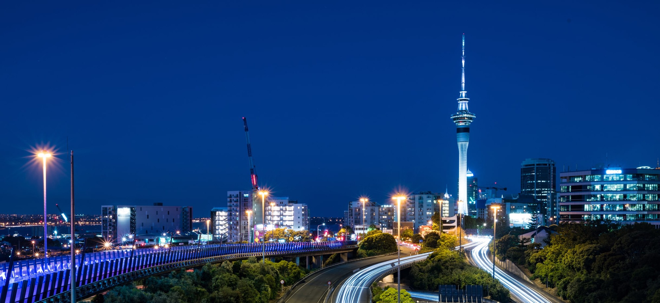
6.
Stakeholder perceptions of the Electricity Authority’s engagement and communications

Slide 40
Relationships overall
There is a general acceptance that the relationship between the Authority as a regulator and sector stakeholders should be a little remote.
Those with established relationships are positive about their interactions on a personal level. They often reference their relationships as being cordial, based on mutual respect, and mostly constructive.
However, as previously mentioned, staff churn at the Authority has been disruptive, and many stakeholders are unsure about who to contact. This has led to some referencing the organisation as being difficult to penetrate.
“It's not them against us or us against them. It's actually just people trying to work within the frame.”
Sector
“Personality wise, there are no issues. But as an organisation, we have some difficulty.”
Sector
“It’s like a black box. You don’t know who to ring, and then they won’t answer in some cases.”
Non-sector

Slide 41
Authority is seen to be cautious in its decision making
There is a sense amongst stakeholders that the Authority is overly-cautious in its decision making and veer on the conservative side. For some, this means that decisions are somewhat predictable.
However, a common criticism from stakeholders, is that the Authority is slow to respond.
“They're solid, but they're always a little bit slow to respond. But when they do, it comes out as something quite measured.”
Non-sector
“I think when something quite big happens like those issues with Meridian a couple of years ago, they will come out eventually and say we're doing an investigation, but it just seemed to be like months after the event. They could have come out earlier and said, you know, we're looking at this, and we'll let you know. It just seems when they do make those big announcements, people have already forgotten about what it was.”
Non-sector
“It takes a long time to get any progress and traction on anything.”
Sector

Slide 42
A sense exists that engagement / consultation with the Authority can be insincere
There is a strong perception that the Authority is insincere in its engagement/consultation, and is simply going through the motions.
Many describe the engagement as superficial with the Authority simply ‘paying lip service’. There is a sense that the Authority doesn’t listen or take feedback on board.
Some suggest the Authority undertakes consultation with a pre-determined outcome in mind. Whilst they provide a range of options, there is a sense that is it difficult to shift the Authority from its preferred option. Some describe the Authority as ‘defensive’, or are seen to be ‘defending the undefendable’.
Others express concern that the Authority may be unduly influenced by the larger players in the market.
All of this is particularly frustrating for stakeholders who invest considerable time, effort, and resources into engaging and providing submissions. Some suggest they are often surprised with consultations as there is little forewarning.
"One of my criticisms of the Authority, is they give the appearance of listening, but they're not really hearing.”
Sector
“They have a position and try and find evidence to support that position.”
Sector
“I’ve never come out of an EA meeting, thinking any change is going to happen.”
Sector
“It doesn’t feel genuine… the fact that you've got 29 distributors and a whole bunch generators and retailers that provide feedback, and nothing changes.”
Sector
“My impression is, that the weight of evidence from submitters is based on market share, as opposed to each individual company being viewed as being weighted equally.”
Non-sector

Slide 43
Stakeholders desire more meaningful engagement
For many stakeholders, their primary engagement the Authority is via its weekly market update. This is generally perceived positively in terms of providing an update of what’s going on. Stakeholders would also like insight on macro/future issues.
Most stakeholders express a desire for more meaningful engagement. Sector stakeholders would like the Authority to undertake greater proactive collaboration with industry for example, visiting the regions and hosting forums. Establishing more collaborative and constructive relationships is perceived to be particularly important given the complexity and changes facing the sector, with the potential for wide reaching benefits.
Stakeholders suggest the ideal is a ‘no surprises’ approach to communications – for example, the Authority to provide an indication of what’s on the horizon and associated timelines. Similarly, many express a desire to gain insight of the Authority’s thinking on issues facing the sector.
“They do a weekly email update, which is appreciated. But it'd be good if they had a bit more information on what's coming up. Ideally, we should have a pretty good idea of what matters to the Authority. Where their interest is, and the things that we know they're trying to progress and achieve.”
Sector
“There's a whole lot of new technology coming, now's the time for the Authority to work very closely with industry and industry associations to get the best outcomes. And so, a more collaborative approach between the Authority and all the other players, would probably lead to really good outcomes for New Zealand Inc.”
Sector
“I'd love to see them out in the regions, I'd love to see them spend time with industry players, I'd love to see a lot more meaningful engagement… which isn't just putting submissions out and asking for feedback, and then ignoring it. I'd love to see a true meaningful presence across the industry and the building relationships.”
Sector
“When it comes to the big questions, you just don’t know where they’re at.”
Non-sector

Slide 44
Stakeholders are looking for regulatory certainty
While many stakeholders do not anticipate the Authority playing a direct role in meeting the ‘100% renewable energy by 2030’ or ‘net zero carbon economy by 2050’ targets, stakeholders are looking to the Authority to provide some regulatory certainty, by:
Having the right regulatory settings in place
Facilitating an environment that encourages investment
Understanding impacts on the wholesale market
Exploring different incentive regimes
    For example, water efficiencies, R-factors
Understanding consumer expectations
    For example, self-generation, peer to peer trading
"It needs to have a view as to how the market should actually be shaped, rather than just sitting there.”
Non-sector
“It's pretty clear that electricity is going to be the transition fuel for the nation… that stability of regulatory settings is critical if investment is going to flow into the sector. And let's not underestimate the EA's role in providing and marketing, that stability.”
Sector
“The fundamental question is, can the market survive with 100% renewables?’ And what will the market look like in this environment?”
Non-sector
“With the decarbonisation agenda, there's a constant testing with increased volatility in the markets of market settings with a lot of different stakeholders lobbying for the way they should see the world. That's a challenge for the EA, one, to be seen to be listening, but secondly, to make sure they don’t turn the market upside down inadvertently.”
Sector

Slide 45
Different targets, but similar approach
100% renewable energy by 2030
Some are critical that the Authority did not take a stronger stand and communicate that:
It is a political target (and perceived political influence is a destabilising factor)
The target falls outside of the Authority’s statutory objective
100% renewable is unrealistic, and the effort and cost required to get the last few percent, is not feasible.
Net zero carbon economy by 2050
Stakeholders suggest electricity is only a small part of this target and it will likely involve technology that doesn’t exist today.
“It's the Labour Party's aspirational target, it's not regulation... Trying to get 100% by 2030 is not in the customers’ best interests.. I can tell you that and the Authority would agree…”
Sector
“They had the opportunity early on, to push back on that and say to the Minister, like the independent Climate Change Commission did, that to get the last few percent, to get to 100% is very expensive…. And lacks practicality.”
Non-sector
“As the regulator, they could have been more vocal that it’s a non-scientific, ill-thought out, political statement.”
Sector
“I haven't seen the Authority come out more categorically, because they talk behind closed doors that it’s an impossible target to achieve. The problem with making an impossible target aspirational, is that it actually has other consequences.”
Sector

Slide 46
Differences between 2018 and 2022
Stakeholders acknowledge that the COVID environment has impacted engagement.
In 2018 and 2022, stakeholders continue to express a desire for more meaningful engagement. In 2022, stakeholders express a strong desire for Authority staff to visit the regions to enhance their understanding and re-establish relationships.
Stakeholders remain consistent in perceptions that engagement / consultation is insincere and that the Authority does not take feedback on board.
The targets of ‘100% renewable energy by 2030’ and ‘net zero carbon economy by 2050’ are new in 2022 and top of mind. Stakeholders are looking to the Authority to provide regulatory certainty and a framework that is appropriate with the shift to renewable energy.

Slide 47
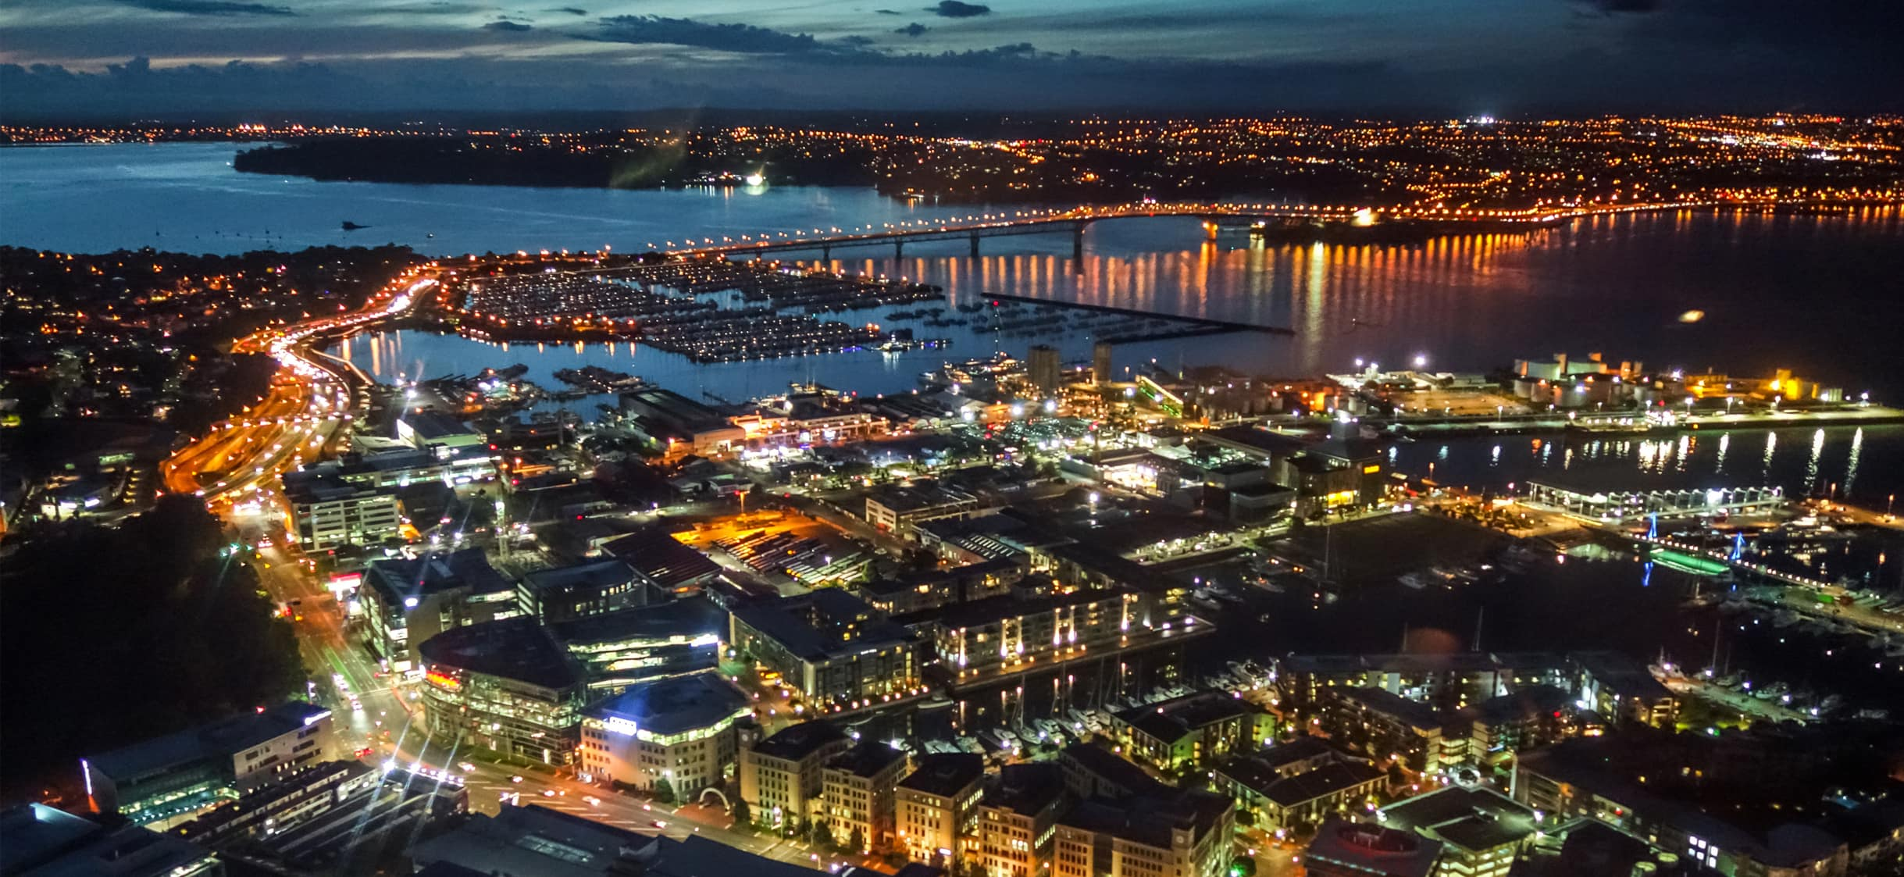
7.
Stakeholder views on how to effectively move forward

Slide 48
Moving forward with effective engagement
1.
2.
Provide greater regulatory certainty
Ensure the regimes and processes in place, are fit for purpose.
Create an environment that facilitates capital investment.
Build capacity and capability of Authority staff
Seek to increase confidence in the sector, that the Authority has the appropriate expertise (and decisions with wide reaching ramifications, have been appropriately informed).
If the expertise doesn’t exist in-house, seek to outsource it.
Effective engagement remains key for stakeholders to feel confident in the regulator and the decisions it makes.
Stakeholders need to respect the Authority and have confidence in the regulatory regime and processes.
Stakeholders suggest this can be achieved through making improvements to the following areas:

Slide 49
3.
4.
5.
Strong future focus
Create an environment where technology can flourish
    Don’t feel the need to reinvent the wheel, look to other jurisdictions for learnings/insight.
Be prepared to be agile and adapt, don’t feel wedded to existing frameworks if they are no longer fit for purpose.
Greater collaboration with industry
Undertake genuine and sincere engagement/consultation.
Recognise the expertise that sits within industry (and seek to utilise this).
Create opportunities to engage with industry and re-build relationships.
Communicate strategy/vision for the sector.
Increased pragmatism
Give greater consideration to real-world impacts.
Seek to balance theoretical approaches with practical implications.

Slide 50


