Slide 1
Trading conduct review: Briefing and Discussion
30 July 2019
Market Development Advisory Group

Slide 2
Project description
On 20 November 2017, the Authority wrote to the MDAG requesting that the MDAG include a review of spot market trading conduct provisions in its 2017/18 work plan. The project description is:
    “Review of trading conduct provisions in light of events that have tested these provisions. Take into account any findings from case studies, performance reports and compliance reports.”
The project aim is:
    “To ensure the trading conduct provisions are effective in promoting outcomes consistent with workable competition.”

Slide 3
Purpose of briefing
The briefing is an interim step in the MDAG’s work on pivotal pricing, which is the initial focus of the MDAG’s work on trading conduct.
MDAG would like to update stakeholders on MDAG’s thinking on how to change the Code in relation to pivotal offers.
We’d like to do this by a relatively informal briefing and discussion.
It is important to note that MDAG has yet to complete its comparative evaluation of Code change options in relation to pivotal pricing.
Also note that the normal consultation process has yet to come. Later this year, MDAG will issue a formal proposal paper setting out in full the analysis and rationale. That paper will invite formal submissions.
In due course, this will be followed by a final recommendations report from MDAG to the Authority’s Board.

Slide 4
Details
The briefing will be held 2.30 – 4.30pm, 30 July 2019 (arrival from 2.15pm).
We encourage you to come along to hear more about the project.
Please RSVP to MDAG@ea.govt.nz if you are interested in attending.

Slide 5
Contents of this briefing pack
Understanding pivotal
Current trading conduct provisions – what are they and where did they come from?
MDAG’s preferred change

Slide 6
Meaning of pivotal

Slide 7
Definition of ‘pivotal’
Part 1 of the Code:
  pivotal means—
  (a) in relation to a generator, that the total demand in a trading period at any 1 or more nodes would not have been met if the generator had not submitted offers for all or any of its generating plant; and
  (b) in relation to an ancillary service agent, that the total demand in a trading period for an ancillary service supplied by the ancillary service agent in an island would not have been met if the ancillary service agent had not submitted reserve offers for all or any of its capacity to provide instantaneous reserve in the island

Slide 8
Illustration of ‘pivotal’
No generator is pivotal
30, 30, 20 MW all pivotal
15
20
20
40
404
40
404
15
15
30
30
404
404
40
40
404
404
30
30
Load
Generation
Load
Generation
Both generators are pivotal
Only 60MW pivotal
15
404
15
40
35
40
15
404
404
40
60
40
60
Load
Generation
Load
Generation

Slide 9
Definition of ‘net pivotal’
From WAG discussion paper:
“A net pivotal supplier is a party that is required to generate to avoid unserved load and whose generation is greater than its own retail and hedge sales in the relevant area”
Reflected by clause 13.5B(1)(c)(iii) and 13.5B(3)(c)(iii) in safe harbours:
  13.5B(1)(c)(iii) the generator does not benefit financially from an increase in the final price at which electricity is supplied in a trading period at a node at which the generator is pivotal
  13.5B(3)(c)(iii) the ancillary service agent does not benefit financially from an increase in the final reserve price in a trading period in an island in which the ancillary service agent is pivotal

Slide 10
Net pivotal incentives
When a supplier is net pivotal they have incentives to raise prices because:
their hedge position, including retail, provides no financial constraint
they lack competitive pressure, ie they have market power
Accordingly, the trading conduct safe harbour provisions consider whether a generator or ancillary service agent is net pivotal:
  13.5B(1)(c)(iii) the generator does not benefit financially from an increase in the final price at which electricity is supplied in a trading period at a node at which the generator is pivotal
  13.5B(3)(c)(iii) the ancillary service agent does not benefit financially from an increase in the final reserve price in a trading period in an island in which the ancillary service agent is pivotal

Slide 11
Fully hedged pivotal incentives
A supplier that is pivotal but not net pivotal, ie with generation ≈ hedges/retail, may still have incentives to raise prices in the short term:
it may allow the supplier to supply hedges at a higher premium in the future
it may undermine more exposed competitors and potentially force them to leave the market
Accordingly, a party that is pivotal could potentially be in the trading conduct safe harbour because they do not “benefit financially” from high prices in the short term, even though they might in the long term

Slide 12
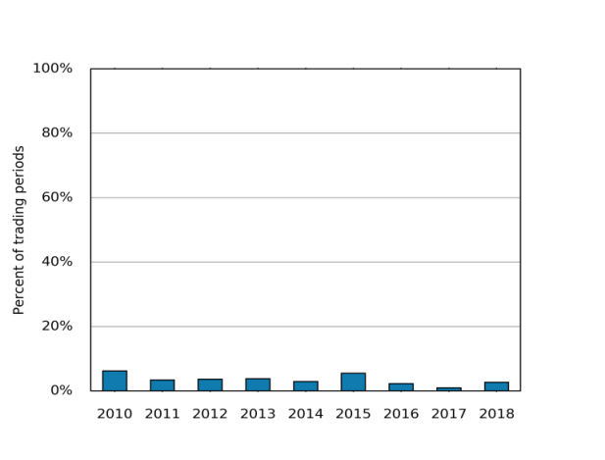
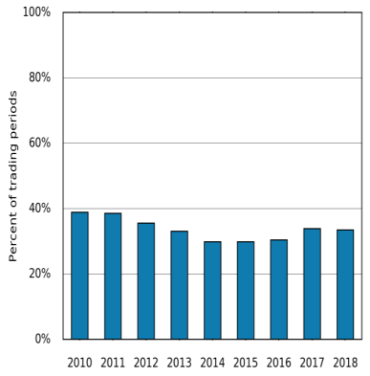
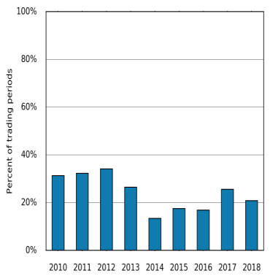
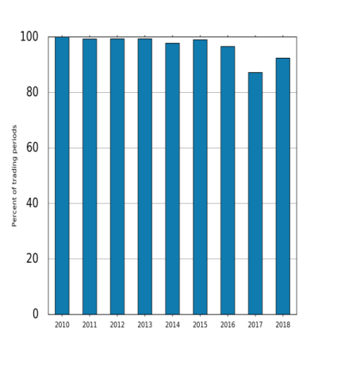
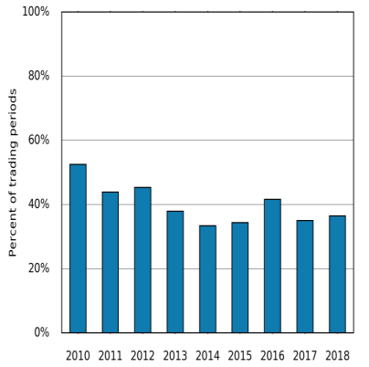
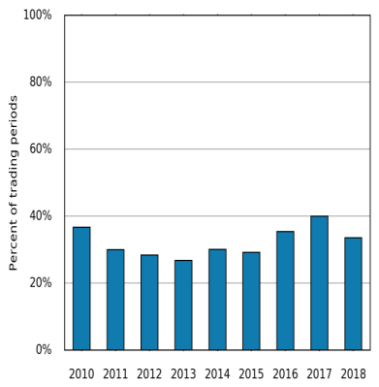
Generators are often pivotal
Modelled by setting prices to $30k for plant in region shown (eg Contact, South Island means setting Contact’s SI plant to $30k)
Graphs show percentage of time the supplier’s generation in that region (ie North Island, South Island, across New Zealand) is required to meet national demand
Note the Code considers whether a party is pivotal on a nodal basis
Contact,
South Island
Contact,
New Zealand
Contact,
North Island
Meridian,
South Island
Genesis,
North Island
Mercury,
North Island

Slide 13
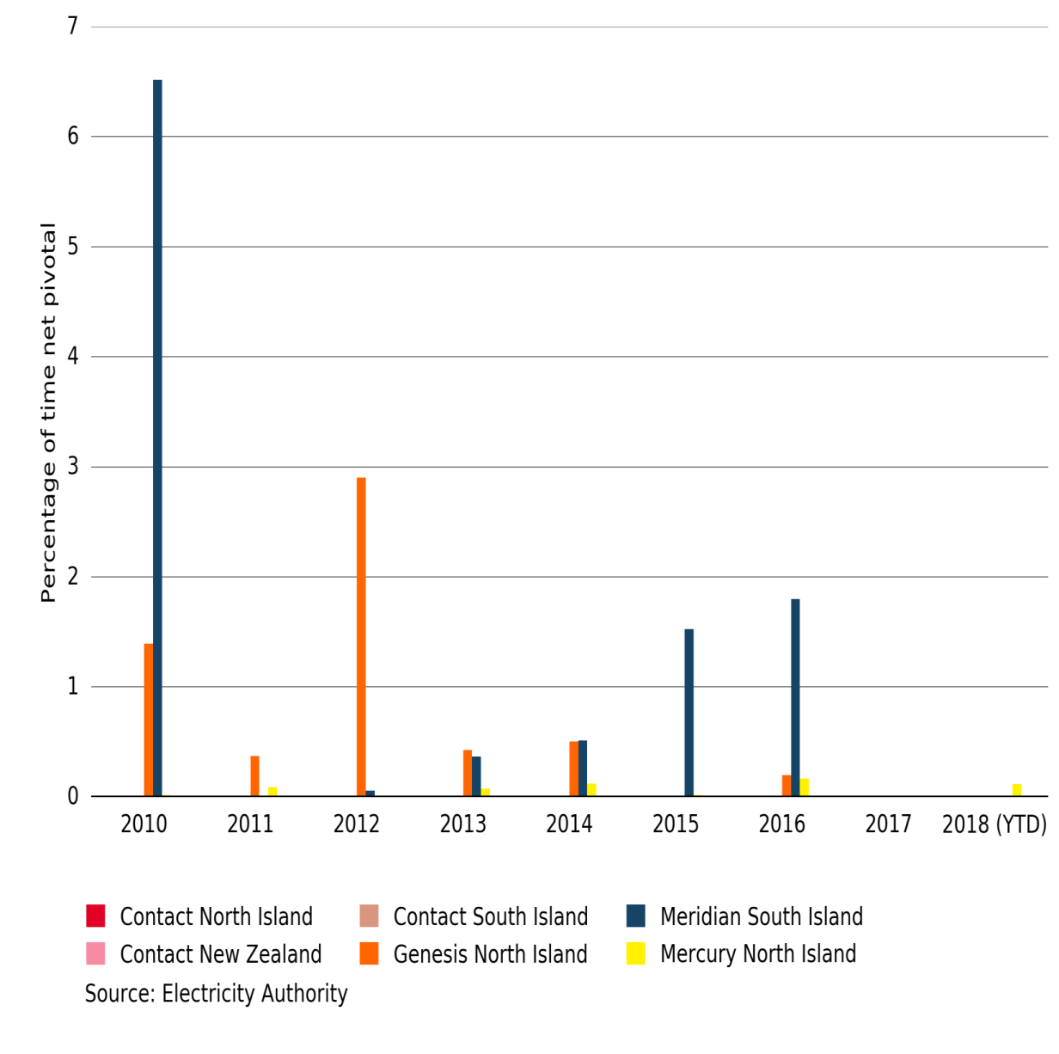
Generators are less often net pivotal

Slide 14
Current trading conduct provisions

Slide 15
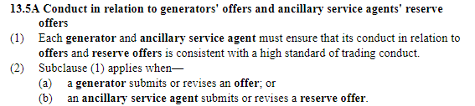
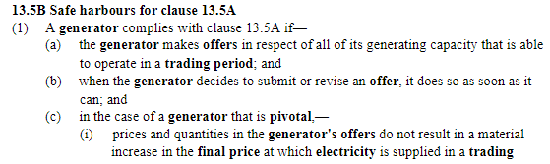
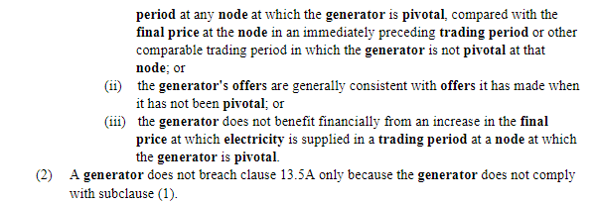
The trading conduct provisions in the Code are as follows:

Slide 16
Trading conduct provisions continued:

Slide 17
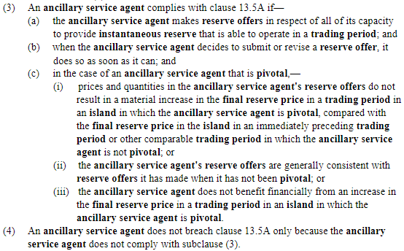
Trading conduct provisions continued:
.
.
.

Slide 18
Overview of trading conduct provisions
13
.
5
Bids and offers
(
i
must be lawful
)
Pivotal
generator’s offer
results in material
Consistent with
increase in price c
.
f
.
No
a HSOTC
13.5A Generators and ancillary agents’ offers consistent with a HSOTC?
Consistent with
previous period or
a HSOTC
when not
pivotal
?
No
No
No
Yes
13
.
5
B Safe harbour
1(a) Offers
all capacity
1(b) Timely
offer updates
1(c) Pivotal
at node(s)
A generator complies
Yes
Yes
Yes
(
ii
with
13
)
Offer
.
5
A if
:
consistent with
Consistent with
offers when not
Yes
a HSOTC
pivotal
?
No
(
iii
)
Generator
Trader
outside the
No
does not benefit
Yes
Consistent with
safe harbour
financially from
a HSOTC
increase in
price
?
Diagram adapted from Sapere presentation to MDAG, 15 March 2018

Slide 19
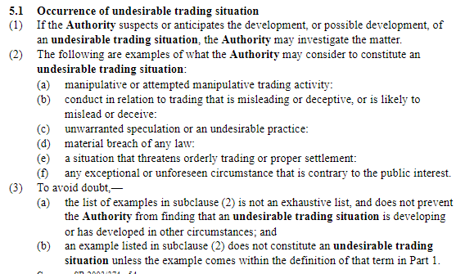
UTS provisions
The relationship between the Code’s provisions on “high standard of trading conduct” and “undesirable trading situations” is unclear

Slide 20
Origin of current provisions

Slide 21
Origin of HSTC provisions
In 2012, the Authority asked WAG to consider issues relating to pivotal supplier situations.
WAG did not identify any specific efficiency losses arising from local or wider pivotal situations; however, WAG’s analysis indicated “potential for material efficiency loses to arise in some scenarios”.
Given the uncertainty as to the extent of potential efficiency losses, WAG advised that any change should:
  have a relatively low risk of unintended consequence,
  be flexible, and
  be relatively easy to reverse.
WAG recommended a “high standard of trading conduct” provision (‘HSTC’) for generators and ancillary agents with a pivotal position at an island wide or national level.
The Authority decided that the HSTC provision should apply to all parties making offers.

Slide 22
Origin of HSTC provisions (cont’d)
As the Authority states in its 2017 Meridian decision: “the high standard of trading conduct provisions were introduced to improve the efficiency of prices in pivotal supplier situations”.
However, instead of promulgating a set of provisions targeted at pivotal supplier situation, WAG and the Authority opted for an unusual combination of:
  A ‘motherhood and apple pie’ standard with broad application – “high standard of conduct” – which is poorly defined at law and uncertain in its scope and practical effect in this market; and
  A specific carve-out (safe-harbour) relating to a narrow aspect of but one dimension trading behaviour.
WAG seems to have assumed that this option satisfies its three criteria (previous slide). However, WAG does not seem to have undertaken any detailed analysis of its likely scope or effect, in law or practice.

Slide 23
Origin of HSTC provisions (cont’d)
It was intended that the scope, meaning and application of this HTSC mechanism would become better defined over time as it is applied to specific cases and a body of enforcement decisions evolves.
In other words, the boundaries and effect of what is a very broadly worded standard (HSTC) are to be determined by a process of incremental interpretation and application by the Authority, the Rulings Panel and (ultimately) the courts.
Since the HSTC provisions were promulgated, there have been two compliance investigations, both of which related to alleged misuse of a pivotal position.

Slide 24
MDAG’s preferred change

Slide 25
Key elements
This option involves:
  deleting the existing trading conduct provisions in the Code (clauses 13.5A and 13.5B, at least in so far as these provisions apply to offers made by pivotal suppliers)
  retaining the existing definition of ‘pivotal’ in Part 1 of the Code
  introducing new provisions to the Code applying specifically to suppliers in a pivotal position. These provisions would require pivotal suppliers to make offers consistent with offers they would make under workable competition.

Slide 26
Indicative new provisions
The new provisions would reflect the following:
  “a) In making offers, generators and ancillary service agents must ensure that their offers are consistent with offers they would make when they are subject to workable competition
  b) In assessing whether offers comply with (a), generators and ancillary service agents, or the Authority, as appropriate, must consider whether the offer would promote efficient:
  locational signals for suppliers (generators and other providers of electricity services) and consumers
  consumption decisions by consumers
  investment by both suppliers and consumers
  risk management and risk management markets
  c) The assessment under (b) must demonstrate how the impact under (b)(i) – (iv) would reflect workable competition
  d) For generators, the assessment under (b) must be with respect to both the region in which the generator is located and regions supplied by the generator.”
Notes:
* This reflects the Authority’s interpretation of the statutory objective, where it interpreted ‘competition’ to mean ‘workable competition’. See Electricity Authority, Interpretation of statutory objective 14 February 2011, paragraph 2.2.1(a), available at: https://www.ea.govt.nz/dmsdocument/9494-interpretation-of-the-authoritys-statutory-objective-february-2011

Slide 27
Advantages
Relative to the status quo, the advantages of this option are that it:
more directly targets the problem identified in relation to behaviour by pivotal suppliers, namely that offers by such parties may result in prices and therefore outcomes that do not promote efficiency
aligns the relevant test in the Code with the framework and the criteria used by the Authority in relation to pivotal issues
focuses on offers, which are within suppliers’ control, rather than prices, which may be the result of factors outside suppliers’ control
is applicable to suppliers in any pivotal situation, be it temporary or permanent, local, regional or national
doesn’t rely on the legally nebulous concept of a ‘high standard of trading conduct’ (HSOTC)
reduces the risk of the Courts introducing considerations into the evaluation (under the rubric of a HSOTC) that are extraneous to the way in which the Authority would evaluate pivotal events
avoids unintended incentives and outcomes from the technical safe harbour definitions under the current clause 13.5B of the Code.

Slide 28
Other considerations
Other considerations in relation to this option are:
it is based on economic concepts, so would require parties that may be subject to the requirements to become familiar with those concepts and reflect them in offer decisions
like the status quo, it is likely to require development of a pattern of enforcement decisions, and possibly guidelines, in order to be fully effective over time
it utilises terms, eg workable competition, that have established legal meanings in relevant contexts (see next slides)
it focuses only on pivotal and does not seek to address other behaviours that may leads to inefficient outcomes in the market, which are better addressed by other mechanisms to be introduced into the Code
it only applies to parties making offers, so may not capture all parties that may be pivotal (however, this could be potentially addressed by expanding its application to supply decisions by all parties supplying the electricity market that are pivotal).

Slide 29
Leading judicial authorities on concept of “workable competition”
NZME LIMITED v COMMERCE COMMISSION [2018] NZCA 389 [26 September 2018]
[NZ Court of Appeal] - http://img.scoop.co.nz/media/pdfs/1809/2018NZCA389_NZMEvComCom.pdf
At para [34]:
“The concept of “workable” or “effective” competition is traced, via Re Queensland Co-operative Milling Association Ltd (QCMA),27 to the 1955 Report of the United States Attorney-General’s National Committee to Study the Antitrust Laws:²⁸
“The basic characteristic of effective competition in the economic sense is that no one seller, and no group of sellers acting in concert, has the power to choose its level of profits by giving less and charging more. Where there is workable competition, rival sellers, whether existing competitors or new or potential entrants into the field, would keep this power in check by offering or threatening to offer effective inducements …”
Footnote 28:
Stanley N Barnes and S Chesterfield Oppenheim Report of the United States Attorney-General’s National Committee to Study the Antitrust Laws (United States Department of Justice, March 1955) at 320. The concept is further traceable to the work of the Harvard economist Edward S Mason: see the discussion in Alan J Meese “Debunking the Purchaser Welfare Account of Section 2 of the Sherman Act: How Harvard Brought Us a Total Welfare Standard and Why We Should Keep It” (2010) 85 NYU L Rev 659 at 692–693.

Slide 30
Leading judicial authorities on “efficiency”
GODFREY HIRST NZ LIMITED V COMMERCE COMMISSION [2016] NZCA 560 [30 November 2016]
[NZ Court of Appeal]
- https://comcom.govt.nz/__data/assets/pdf_file/0036/69399/Godfrey-Hirst-NZ-Ltd-v-Commerce-Commission-Court-of-Appeal-Judgment-30-November-2016.PDF
At para [13], the Court of Appeal also cited with approval its 1988 decision in Tru Tone Limited v Festival Records Marketing Limited*, which held that:
“[the Commerce Act] is based on the premise that society’s resources are best allocated in a competitive market where rivalry between firms ensures maximum efficiency in the use of resources”.
Footnote *: [1988] 2 NZLR 352 at 358
At para [16], the Court of Appeal further noted its earlier decision in Tru Tone Ltd:
“[The Court of Appeal]…does not view the promotion of competition as an end in itself but, rather, as a vehicle for fostering overall economic efficiency.”

Slide 31
2. Leading judicial authorities on “efficiency” (cont’d)
At para [19], the Court of Appeal cited with approval the High Court’s decision in AMPS-A HC²⁶, which among other things held that efficiency has three dimensions:
“We bear in mind that efficiency has three dimensions commonly referred to as allocative efficiency, production efficiency and dynamic efficiency”.
Footnote 26:
Telecom Corporation of New Zealand Ltd v Commerce Commission (1991) 4 TCLR 473 (HC) [AMPS-A HC]
At para [20], the Court of Appeal also noted that:
“Efficiency became an established pillar of New Zealand’s competition law and policy”.
This definition of efficiency was established in the context of the Commerce Act, however the relevant language is closely analogous to the use and context of “efficiency” in the Electricity Authority’s statutory purpose.

Slide 32
Electricity Authority’s objective in relation to pivotal pricing
The Authority’s stated objective in relation to pivotal pricing is “to improve the efficiency of prices”:
Authority on 2 June 2016:
“Meridian used its pivotal position to cover its unhedged risk.., which essentially resulted in the cost of the risk being met by other parties. The high standard of trading conduct provisions were introduced to improve the efficiency of prices in pivotal supplier situations and the Board would have expected Meridian to have adopted more responsible trading behaviour, either by covering its risk using other available risk management products or bearing the cost of the risk if it eventuates”
Note:
Other useful judicial citations in relation to “economic efficiency”
http://www.nzlii.org/cgi-bin/LawCite?cit=%5b1992%5d%203%20NZLR%20429?query=%22economic%20efficiency%22

